Slide 1
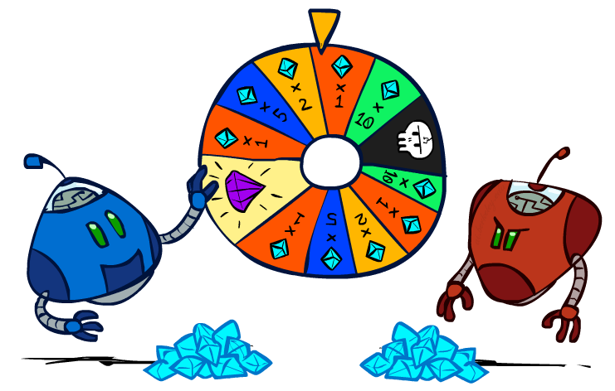
CS 188: Artificial Intelligence
Search with other Agents II
Instructor: Anca Dragan
University of California, Berkeley
[These slides adapted from Dan Klein and Pieter Abbeel]
Notes:
Please retain proper attribution, including the reference to ai.berkeley.edu. Thanks!

Slide 2
Minimax Implementation (Dispatch)
def value(state):
if the state is a terminal state: return the state’s utility
if the next agent is MAX: return max-value(state)
if the next agent is MIN: return min-value(state)
def max-value(state):
initialize v = -∞
for each successor of state:
v = max(v, value(successor))
return v
def min-value(state):
initialize v = +∞
for each successor of state:
v = min(v, value(successor))
return v
Notes:
Max: start high, keep a current estimate of the max, update it as you see more children – important later
Pick an order for two reasons: sequential processor and pruning

Slide 3
Minimax Example
3
3
2
2
3
12
8
2
4
6
14
5
2

Slide 4

Minimax Efficiency
How efficient is minimax?
Just like (exhaustive) DFS
Time: O(b^{m})
Space: O(bm)
Example: For chess, b ≈ 35, m ≈ 100
Exact solution is completely infeasible
But, do we need to explore the whole tree?
Notes:
If you could brute force your way, chess would be solved. It would probably be a draw.
Don’t play chess, just say eh, it’s a draw.

Slide 5

Resource Limits

Slide 6
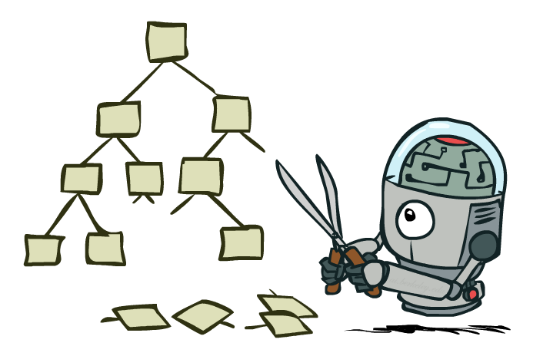
Game Tree Pruning

Slide 7
Minimax Example
3
3
<=2
2
3
12
8
2
14
5
2

Slide 8
Alpha-Beta Pruning
General configuration (MIN version)
We’re computing the MIN-VALUE at some node n
We’re looping over n’s children
n’s estimate of the childrens’ min is dropping
Who cares about n’s value? MAX
Let a be the best value that MAX can get at any choice point along the current path from the root
If n becomes worse than a, MAX will avoid it, so we can stop considering n’s other children (it’s already bad enough that it won’t be played)
MAX version is symmetric
MAX
MIN
a
MAX
MIN
n

Slide 9
Alpha-Beta Implementation
α: MAX’s best option on path to root
β: MIN’s best option on path to root
def max-value(state, α, β):
initialize v = -∞
for each successor of state:
v = max(v, value(successor, α, β))
if v ≥ β return v
α = max(α, v)
return v
def min-value(state , α, β):
initialize v = +∞
for each successor of state:
v = min(v, value(successor, α, β))
if v ≤ α return v
β = min(β, v)
return v
Notes:
If we’re min, we are evaluating our options, and the best we can do keeps decreasing as we see more children
If we ever reach a value where we would force something smaller than a choice that max can force, alpha, then we just give up and return that -- we don’t bother going further; max is never going to let us get here, max is going to force the path to alpha instead
if however we find that this is an option that

Slide 10
Alpha-Beta Pruning Properties
This pruning has no effect on minimax value computed for the root!
Values of intermediate nodes might be wrong
Important: children of the root may have the wrong value
So the most naïve version won’t let you do action selection
Good child ordering improves effectiveness of pruning
With “perfect ordering”:
Time complexity drops to O(b^{m/2})
Doubles solvable depth!
Full search of, e.g. chess, is still hopeless…
This is a simple example of metareasoning (computing about what to compute)
max
min
10
10
0

Slide 11
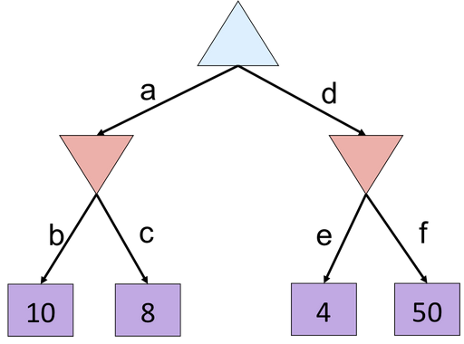
Alpha-Beta Quiz
Notes:
f

Slide 12
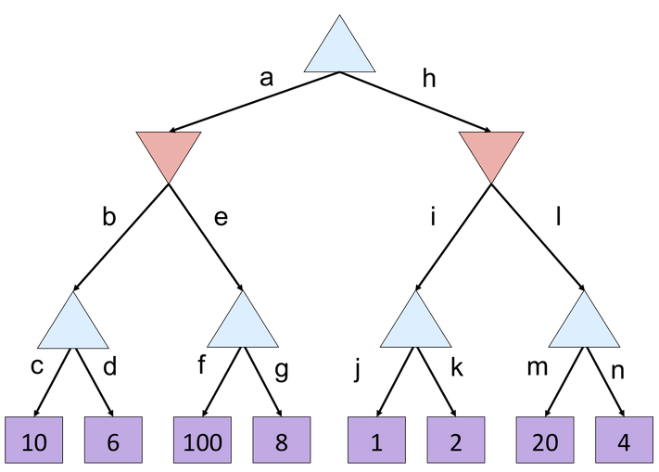
Alpha-Beta Quiz 2
2
Notes:
G, m,n

Slide 13
Alpha-Beta Quiz 2
10
<=2
>=100
2
10
Notes:
G, m,n

Slide 14
Resource Limits
Problem: In realistic games, cannot search to leaves!
Solution: Depth-limited search
Instead, search only to a limited depth in the tree
Replace terminal utilities with an evaluation function for non-terminal positions
Example:
Suppose we have 100 seconds, can explore 10K nodes / sec
So can check 1M nodes per move
α-β reaches about depth 8 – decent chess program
Guarantee of optimal play is gone
More plies makes a BIG difference
Use iterative deepening for an anytime algorithm
max
4
-2
4
min
-1
-2
4
9
?
?
?
?

Slide 15

Video of Demo Limited Depth (2)

Slide 16
Video of Demo Limited Depth (10)

Slide 17
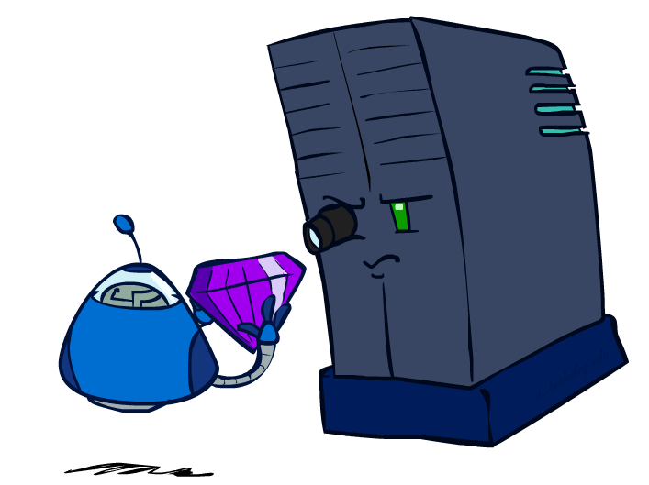
Evaluation Functions

Slide 18
Evaluation Functions
Evaluation functions score non-terminals in depth-limited search
Ideal function: returns the actual minimax value of the position
In practice: typically weighted linear sum of features:
e.g. f₁(s) = (num white queens – num black queens), etc.

Slide 19
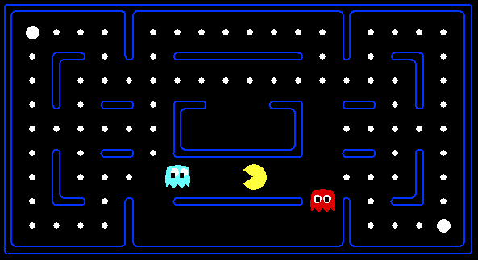




Evaluation for Pacman
[Demo: thrashing d=2, thrashing d=2 (fixed evaluation function), smart ghosts coordinate (L6D6,7,8,10)]

Slide 20
Video of Demo Thrashing (d=2)

Slide 21
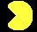
Why Pacman Starves
A danger of replanning agents!
He knows his score will go up by eating the dot now (west, east)
He knows his score will go up just as much by eating the dot later (east, west)
There are no point-scoring opportunities after eating the dot (within the horizon, two here)
Therefore, waiting seems just as good as eating: he may go east, then back west in the next round of replanning!

Slide 22
Video of Demo Thrashing -- Fixed (d=2)

Slide 23
Video of Demo Smart Ghosts (Coordination)

Slide 24
Video of Demo Smart Ghosts (Coordination) – Zoomed In

Slide 25
Evaluation Functions

Slide 26
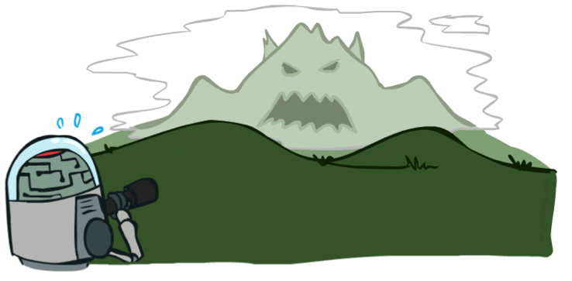

Depth Matters
Evaluation functions are always imperfect
The deeper in the tree the evaluation function is buried, the less the quality of the evaluation function matters
An important example of the tradeoff between complexity of features and complexity of computation
[Demo: depth limited (L6D4, L6D5)]

Slide 27
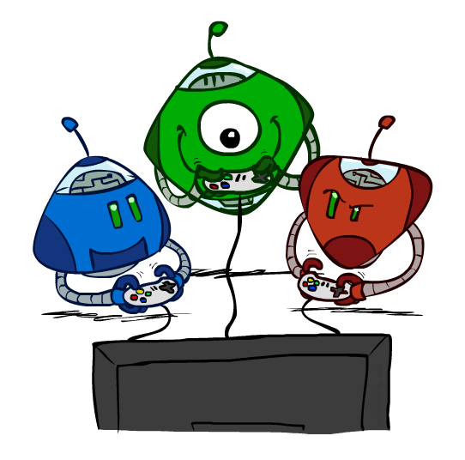
Other Game Types

Slide 28
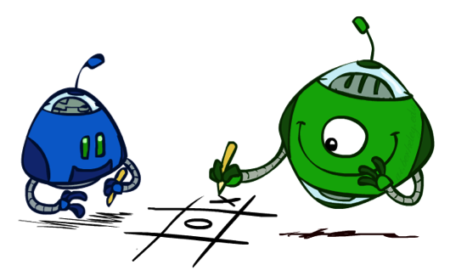
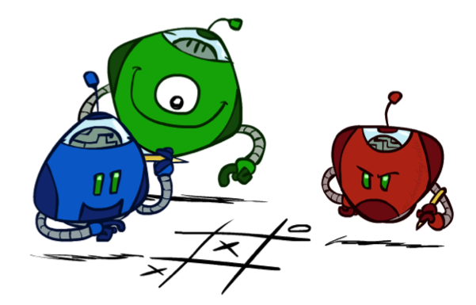
Multi-Agent Utilities
What if the game is not zero-sum, or has multiple players?
Generalization of minimax:
Terminals have utility tuples
Node values are also utility tuples
Each player maximizes its own component
Can give rise to cooperation and
competition dynamically…
1,6,6
1,6,6
7,1,2
6,1,2
7,2,1
5,1,7
1,5,2
7,7,1
5,2,5
Notes:
Green and blue aligned on the left
In the right part, they compete
Complex behavior emerges from simple computation

Slide 29
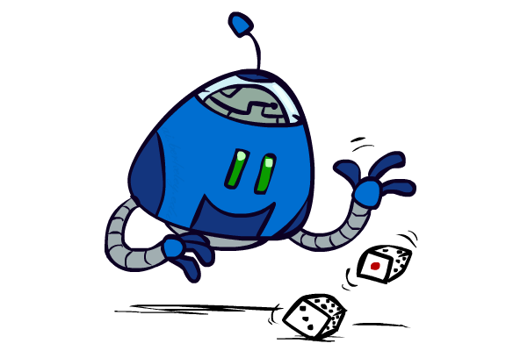
Uncertain Outcomes

Slide 30
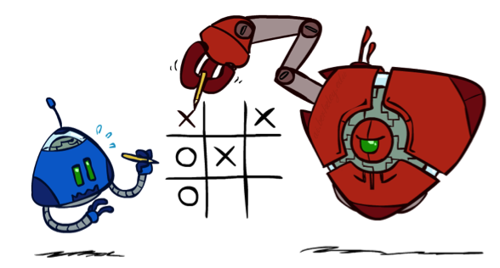

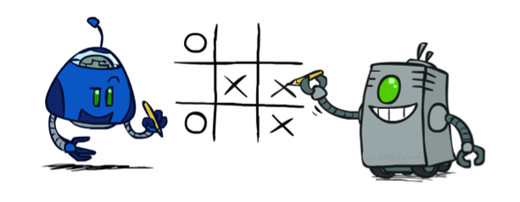
Worst-Case vs. Average Case
max
min
10
10
9
100
Idea: Uncertain outcomes controlled by chance, not an adversary!
Notes:
At least 10, or otherwise just rather dead; or just 100, or otherwise rather dead; that’s yet something different than minimax or expectimax

Slide 31
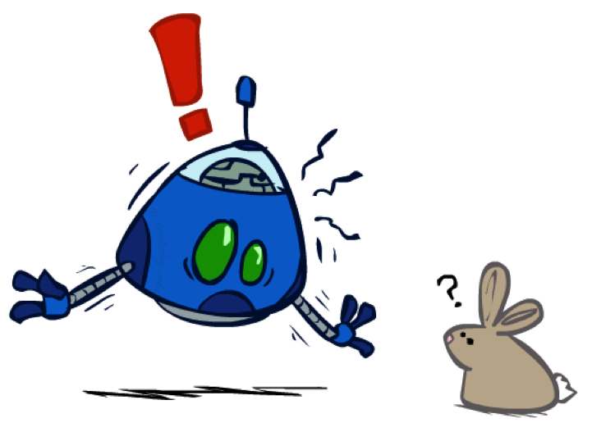
Why not minimax?
Worst case reasoning is too conservative
Need average case reasoning

Slide 32
Expectimax Search
Why wouldn’t we know what the result of an action will be?
Explicit randomness: rolling dice
Unpredictable opponents: the ghosts respond randomly
Unpredictable humans: humans are not perfect
Actions can fail: when moving a robot, wheels might slip
Values should now reflect average-case (expectimax) outcomes, not worst-case (minimax) outcomes
Expectimax search: compute the average score under optimal play
Max nodes as in minimax search
Chance nodes are like min nodes but the outcome is uncertain
Calculate their expected utilities
I.e. take weighted average (expectation) of children
Later, we’ll learn how to formalize the underlying uncertain-result problems as Markov Decision Processes
max
chance
10
10
4
10
5
9
7
100
[Demo: min vs exp (L7D1,2)]

Slide 33
Video of Demo Minimax vs Expectimax (Min)
Notes:
Divebomb the ghost or make a try – make a try is doomed, thus divebomb

Slide 34
Video of Demo Minimax vs Expectimax (Exp)

Slide 35
Expectimax Pseudocode
def value(state):
if the state is a terminal state: return the state’s utility
if the next agent is MAX: return max-value(state)
if the next agent is EXP: return exp-value(state)
def max-value(state):
initialize v = -∞
for each successor of state:
v = max(v, value(successor))
return v
def exp-value(state):
initialize v = 0
for each successor of state:
p = probability(successor)
v += p * value(successor)
return v
Notes:
Pick an order for two reasons: sequential processor and pruning

Slide 36
Expectimax Pseudocode
def exp-value(state):
initialize v = 0
for each successor of state:
p = probability(successor)
v += p * value(successor)
return v
1/2
1/6
1/3
5
8
7
24
-12
v = (1/2) (8) + (1/3) (24) + (1/6) (-12) = 10

Slide 37
Expectimax Example
3
12
9
2
4
6
15
6
0

Slide 38
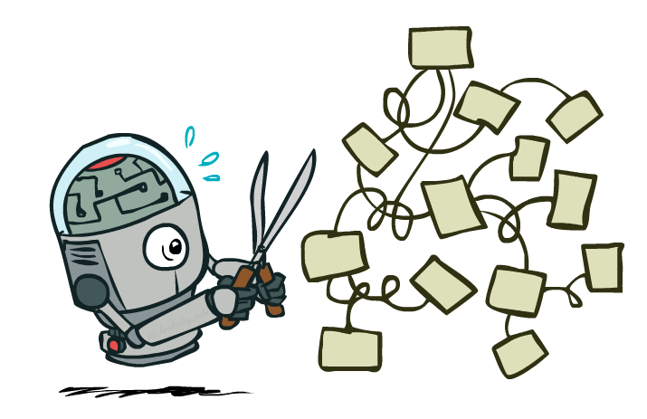
Expectimax Pruning?
3
12
9
2
Notes:
Last node could be 100000 dollars.

Slide 39
Depth-Limited Expectimax
Estimate of true expectimax value (which would require a lot of work to compute)
400
300
…
…
492
362
…

Slide 40
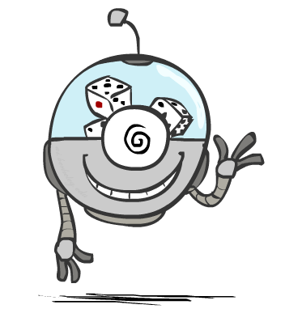
Probabilities

Slide 41
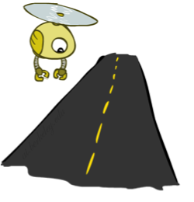
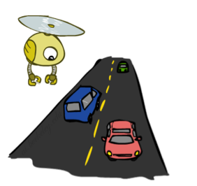
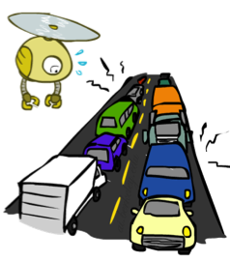
Reminder: Probabilities
A random variable represents an event whose outcome is unknown
A probability distribution is an assignment of weights to outcomes
Example: Traffic on freeway
Random variable: T = whether there’s traffic
Outcomes: T in {none, light, heavy}
Distribution: P(T=none) = 0.25, P(T=light) = 0.50, P(T=heavy) = 0.25
Some laws of probability (more later):
Probabilities are always non-negative
Probabilities over all possible outcomes sum to one
As we get more evidence, probabilities may change:
P(T=heavy) = 0.25, P(T=heavy | Hour=8am) = 0.60
We’ll talk about methods for reasoning and updating probabilities later
0.25
0.50
0.25

Slide 42
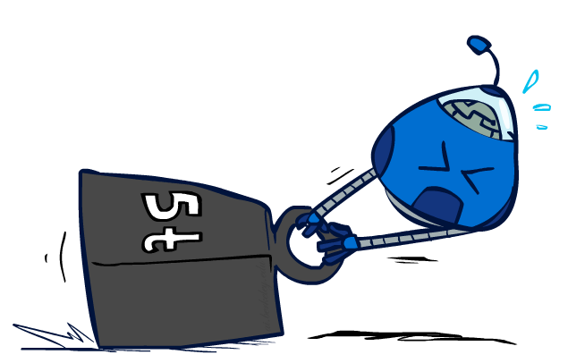
Reminder: Expectations
The expected value of a function of a random variable is the average, weighted by the probability distribution over outcomes
Example: How long to get to the airport?
Time:
20 min
30 min
60 min
+
+
35 min
x
x
x
Probability:
0.25
0.50
0.25

Slide 43

What Probabilities to Use?
In expectimax search, we have a probabilistic model of how the opponent (or environment) will behave in any state
Model could be a simple uniform distribution (roll a die)
Model could be sophisticated and require a great deal of computation
We have a chance node for any outcome out of our control: opponent or environment
The model might say that adversarial actions are likely!
For now, assume each chance node magically comes along with probabilities that specify the distribution over its outcomes
Having a probabilistic belief about another agent’s action does not mean that the agent is flipping any coins!

Slide 44
Quiz: Informed Probabilities
Let’s say you know that your opponent is actually running a depth 2 minimax, using the result 80% of the time, and moving randomly otherwise
Question: What tree search should you use?
Answer: Expectimax!
To figure out EACH chance node’s probabilities, you have to run a simulation of your opponent
This kind of thing gets very slow very quickly
Even worse if you have to simulate your opponent simulating you…
… except for minimax and maximax, which have the nice property that it all collapses into one game tree
0.1 0.9
This is basically how you would model a human, except for their utility: their utility might be the same as yours (i.e. you try to help them, but they are depth 2 and noisy), or they might have a slightly different utility (like another person navigating in the office)

Slide 45

Modeling Assumptions

Slide 46
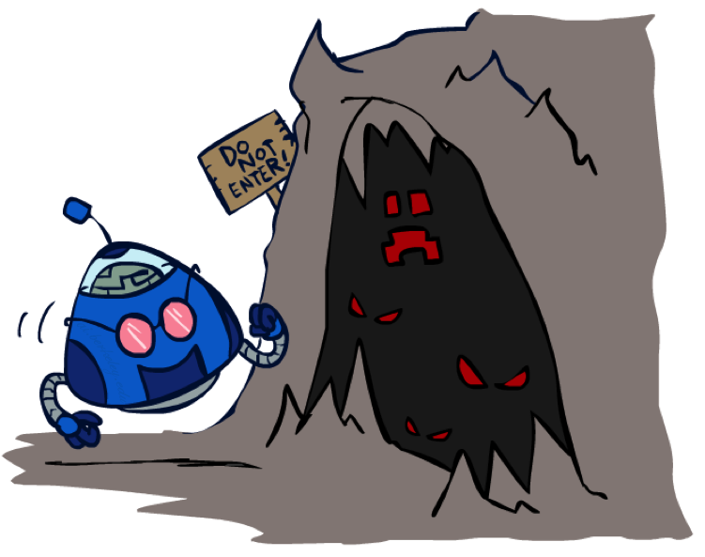

The Dangers of Optimism and Pessimism
Dangerous Optimism
Assuming chance when the world is adversarial
Dangerous Pessimism
Assuming the worst case when it’s not likely

Slide 47
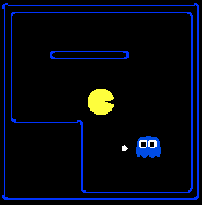
Assumptions vs. Reality
 | Adversarial Ghost | Random Ghost
Minimax Pacman | Won 5/5 Avg. Score: 483 | Won 5/5 Avg. Score: 493
Expectimax Pacman | Won 1/5 Avg. Score: -303 | Won 5/5 Avg. Score: 503
Results from playing 5 games
Pacman used depth 4 search with an eval function that avoids trouble Ghost used depth 2 search with an eval function that seeks Pacman
[Demos: world assumptions (L7D3,4,5,6)]
Notes:
python pacman.py -g SmartGhost -l trapped2 -p ExpectimaxAgent -a depth=4,evalFn=better

Slide 48
Assumptions vs. Reality
 | Adversarial Ghost | Random Ghost
Minimax Pacman | Won 5/5 Avg. Score: 483 | Won 5/5 Avg. Score: 493
Expectimax Pacman | Won 1/5 Avg. Score: -303 | Won 5/5 Avg. Score: 503
Results from playing 5 games
Pacman used depth 4 search with an eval function that avoids trouble Ghost used depth 2 search with an eval function that seeks Pacman
[Demos: world assumptions (L7D3,4,5,6)]
Notes:
python pacman.py -g SmartGhost -l trapped2 -p ExpectimaxAgent -a depth=4,evalFn=better

Slide 49
Video of Demo World Assumptions Random Ghost – Expectimax Pacman

Slide 50
Video of Demo World Assumptions Adversarial Ghost – Minimax Pacman
Notes:
The world is worse, but that’s just life.

Slide 51
Video of Demo World Assumptions Adversarial Ghost – Expectimax Pacman

Slide 52
Video of Demo World Assumptions Random Ghost – Minimax Pacman
Notes:
Any moment now it’s going to bust out its evil plan.

Slide 53



Mixed Layer Types
E.g. Backgammon
Expectiminimax
Environment is an extra “random agent” player that moves after each min/max agent
Each node computes the appropriate combination of its children
Notes:
If it’s terminal or we reached our depth limit, return utility

Slide 54
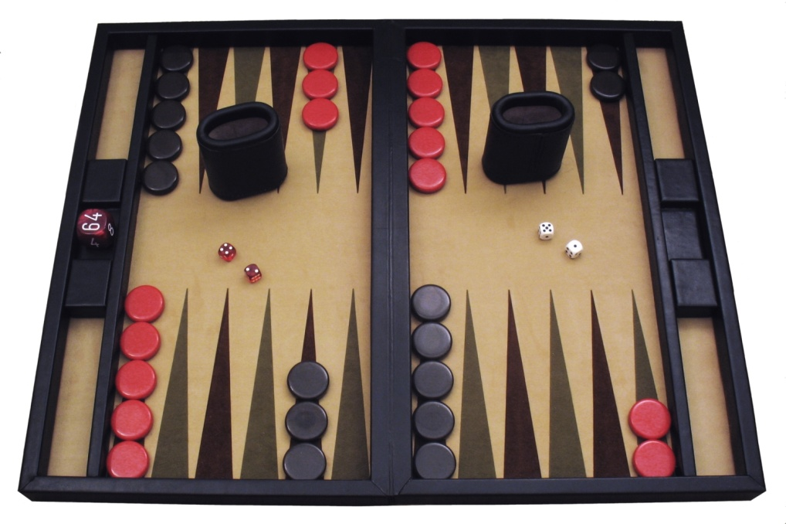
Example: Backgammon
Dice rolls increase b: 21 possible rolls with 2 dice
Backgammon ≈ 20 legal moves
Depth 2 = 20 x (21 x 20)³ = 1.2 x 10⁹
As depth increases, probability of reaching a given search node shrinks
So usefulness of search is diminished
So limiting depth is less damaging
But pruning is trickier…
Historic AI: TDGammon uses depth-2 search + very good evaluation function + reinforcement learning: world-champion level play
1st AI world champion in any game!
Image: Wikipedia

Slide 55
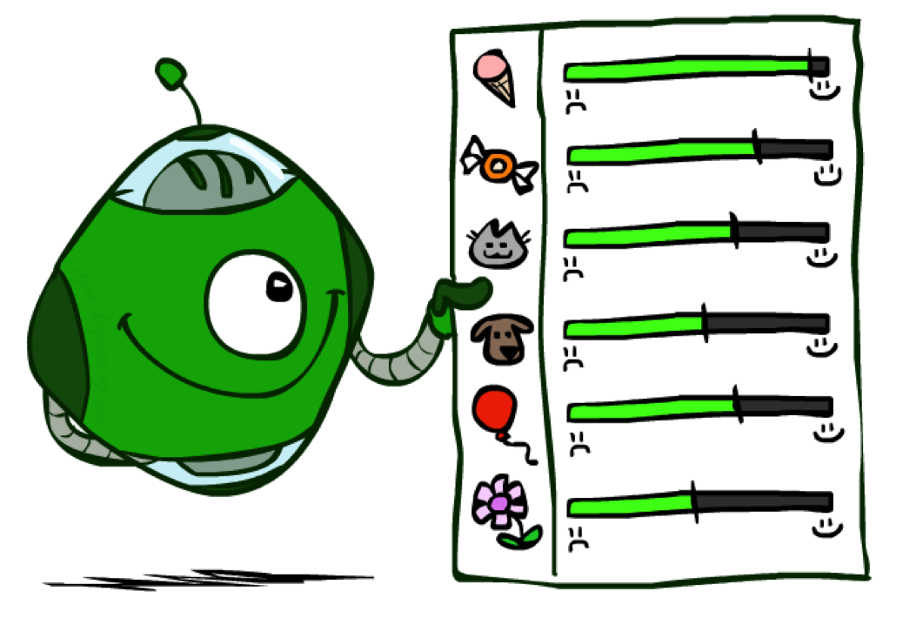
Utilities

Slide 56

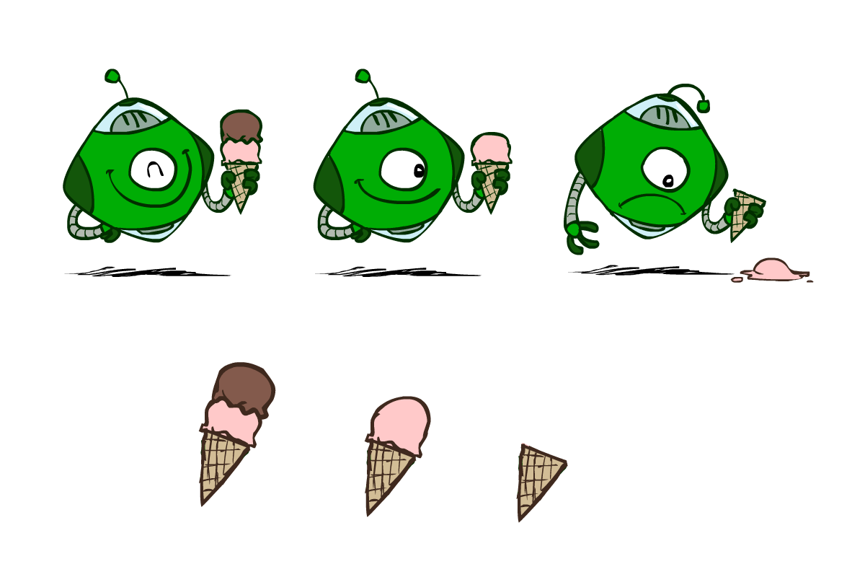
Utilities
Utilities are functions from outcomes (states of the world) to real numbers that describe an agent’s preferences
Where do utilities come from?
In a game, may be simple (+1/-1)
Utilities summarize the agent’s goals
Theorem: any “rational” preferences can be summarized as a utility function
We hard-wire utilities and let behaviors emerge
Why don’t we let agents pick utilities?
Why don’t we prescribe behaviors?

Slide 57
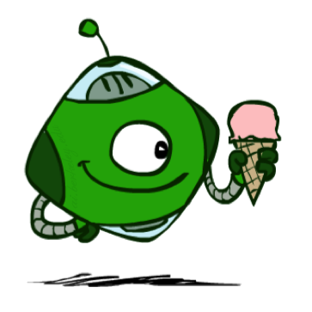
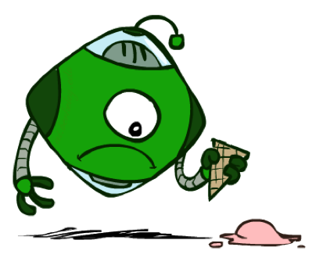
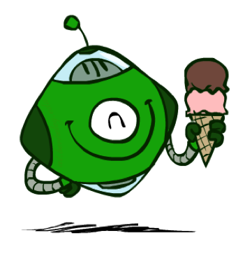
Utilities: Uncertain Outcomes
Getting ice cream
Get Single
Get Double
Oops
Whew!

Slide 58
Maximum Expected Utility
Why should we average utilities? Why not minimax?
Principle of maximum expected utility:
A rational agent should chose the action that maximizes its expected utility, given its knowledge
Questions:
Where do utilities come from?
How do we know such utilities even exist?
How do we know that averaging even makes sense?
What if our behavior (preferences) can’t be described by utilities?

Slide 59
What Utilities to Use?
0
40
20
30
x²
0
1600
400
900
For worst-case minimax reasoning, terminal function scale doesn’t matter
We just want better states to have higher evaluations (get the ordering right)
We call this insensitivity to monotonic transformations
For average-case expectimax reasoning, we need magnitudes to be meaningful

Slide 60
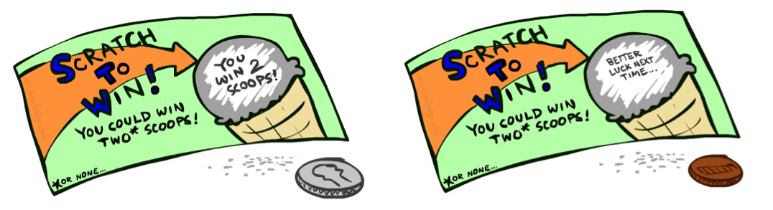
Preferences
A Prize
A Lottery
An agent must have preferences among:
Prizes: A, B, etc.
Lotteries: situations with uncertain prizes
Notation:
Preference:
Indifference:
A
p 1-p
A B
Notes:
An agent can’t just have preferences just based on outcomes, it has to have preferences based on lotteries

Slide 61
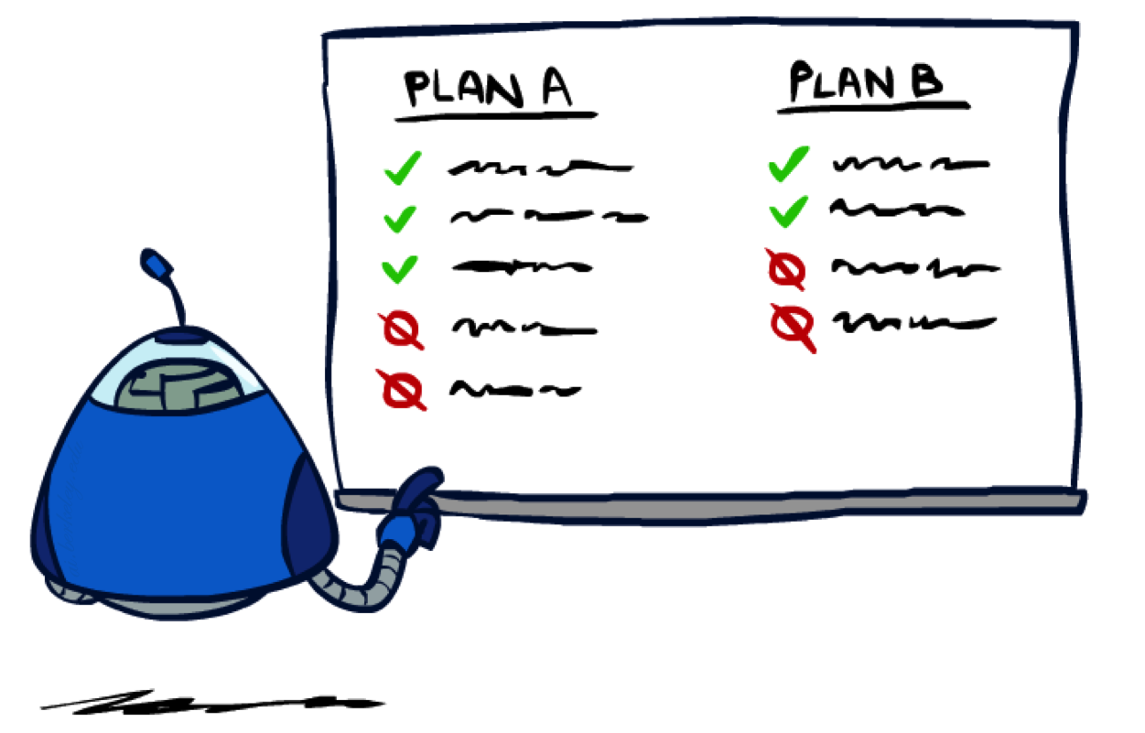
Rationality

Slide 62
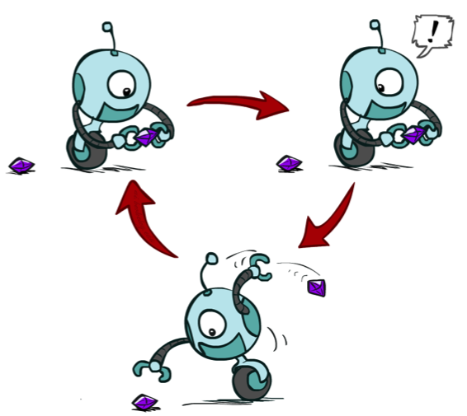
Rational Preferences
We want some constraints on preferences before we call them rational, such as:
For example: an agent with intransitive preferences can
be induced to give away all of its money
If B > C, then an agent with C would pay (say) 1 cent to get B
If A > B, then an agent with B would pay (say) 1 cent to get A
If C > A, then an agent with A would pay (say) 1 cent to get C
Axiom of Transitivity:
Notes:
Apple, banana, carrot

Slide 63

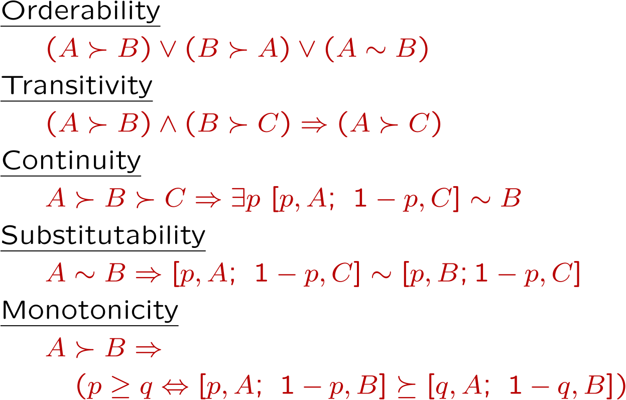
Rational Preferences
The Axioms of Rationality
Theorem: Rational preferences imply behavior describable as maximization of expected utility

Slide 64
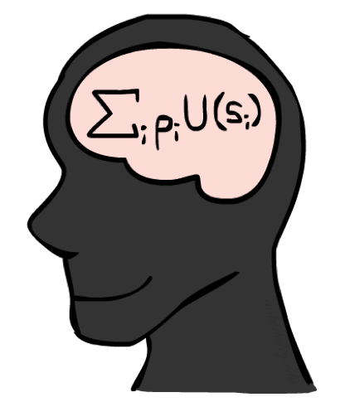
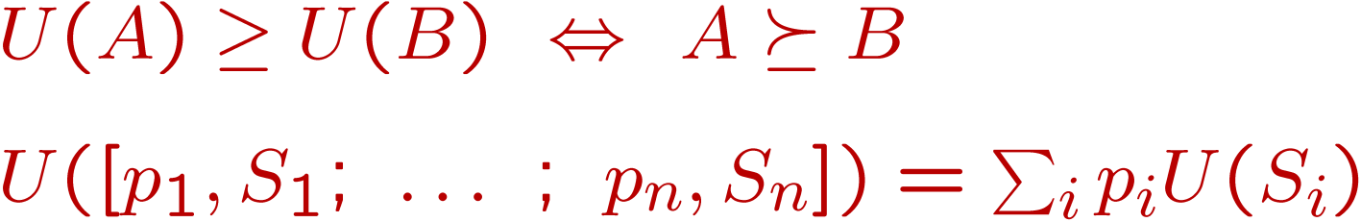
MEU Principle
Theorem [Ramsey, 1931; von Neumann & Morgenstern, 1944]
Given any preferences satisfying these constraints, there exists a real-valued
function U such that:
I.e. values assigned by U preserve preferences of both prizes and lotteries!
Maximum expected utility (MEU) principle:
Choose the action that maximizes expected utility
Note: an agent can be entirely rational (consistent with MEU) without ever representing or manipulating utilities and probabilities
E.g., a lookup table for perfect tic-tac-toe, a reflex vacuum cleaner

Slide 65
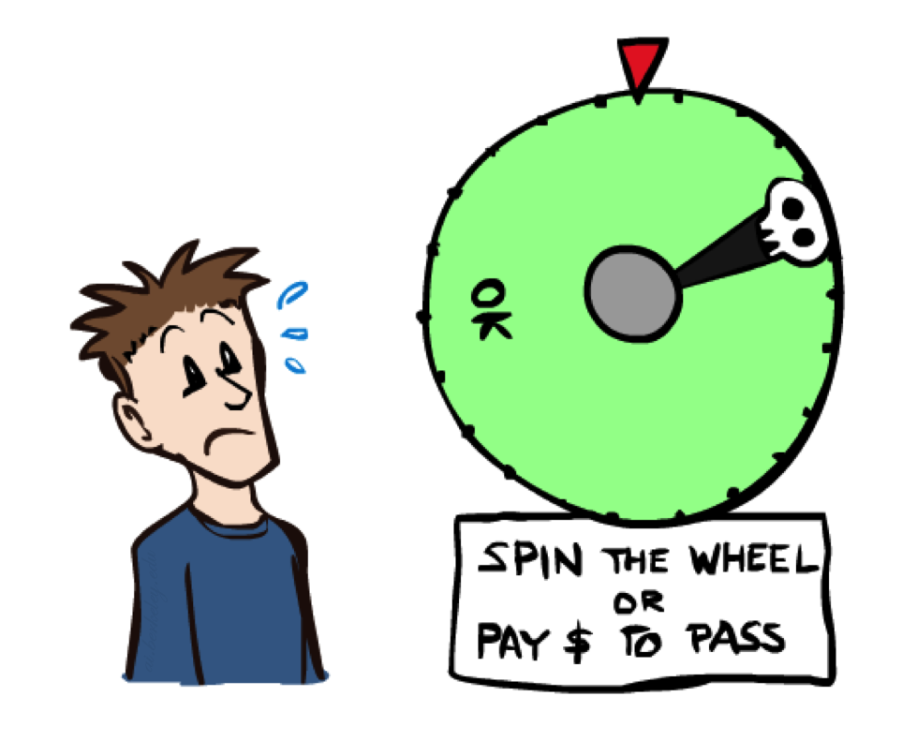
Human Utilities

Slide 66

Utility Scales
Normalized utilities: u₊ = 1.0, u₋ = 0.0
Micromorts: one-millionth chance of death, useful for paying to reduce product risks, etc.
QALYs: quality-adjusted life years, useful for medical decisions involving substantial risk
Note: behavior is invariant under positive linear transformation
With deterministic prizes only (no lottery choices), only ordinal utility can be determined, i.e., total order on prizes

Slide 67


Human Utilities
Utilities map states to real numbers. Which numbers?
Standard approach to assessment (elicitation) of human utilities:
Compare a prize A to a standard lottery L_{p} between
“best possible prize” u₊ with probability p
“worst possible catastrophe” u₋ with probability 1-p
Adjust lottery probability p until indifference: A ~ L_{p}
Resulting p is a utility in [0,1]
Pay $30
0.999999 0.000001
No change
Instant death

Slide 68
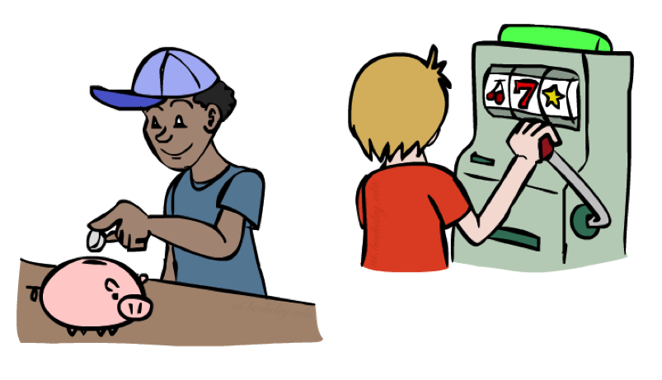
Money
Money does not behave as a utility function, but we can talk about the utility of having money (or being in debt)
Given a lottery L = [p, $X; (1-p), $Y]
The expected monetary value EMV(L) is p*X + (1-p)*Y
U(L) = p*U($X) + (1-p)*U($Y)
Typically, U(L) < U( EMV(L) )
In this sense, people are risk-averse
When deep in debt, people are risk-prone
Notes:
Draw Jensen’s for utility curve

Slide 69
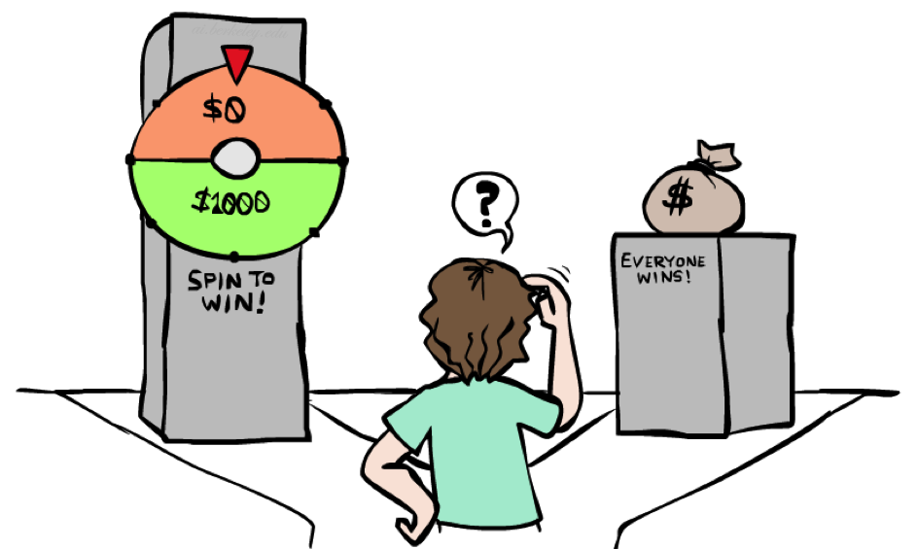
Example: Insurance
Consider the lottery [0.5, $1000; 0.5, $0]
What is its expected monetary value? ($500)
What is its certainty equivalent?
Monetary value acceptable in lieu of lottery
$400 for most people
Difference of $100 is the insurance premium
There’s an insurance industry because people will pay to reduce their risk
If everyone were risk-neutral, no insurance needed!
It’s win-win: you’d rather have the $400 and the insurance company would rather have the lottery (their utility curve is flat and they have many lotteries)

Slide 70

Example: Human Rationality?
Famous example of Allais (1953)
A: [0.8, $4k; 0.2, $0]
B: [1.0, $3k; 0.0, $0]
C: [0.2, $4k; 0.8, $0]
D: [0.25, $3k; 0.75, $0]
Most people prefer B > A, C > D
But if U($0) = 0, then
B > A ⇒ U($3k) > 0.8 U($4k)
C > D ⇒ 0.8 U($4k) > U($3k)

Slide 71
Next Time: MDPs!

Slide 72
What are Probabilities?
Objectivist / frequentist answer:
Averages over repeated experiments
E.g. empirically estimating P(rain) from historical observation
Assertion about how future experiments will go (in the limit)
New evidence changes the reference class
Makes one think of inherently random events, like rolling dice
Subjectivist / Bayesian answer:
Degrees of belief about unobserved variables
E.g. an agent’s belief that it’s raining, given the temperature
E.g. pacman’s belief that the ghost will turn left, given the state
Often learn probabilities from past experiences (more later)
New evidence updates beliefs (more later)

Slide 73
Uncertainty Everywhere
Not just for games of chance!
I’m sick: will I sneeze this minute?
Email contains “FREE!”: is it spam?
Tooth hurts: have cavity?
60 min enough to get to the airport?
Robot rotated wheel three times, how far did it advance?
Safe to cross street? (Look both ways!)
Sources of uncertainty in random variables:
Inherently random process (dice, etc)
Insufficient or weak evidence
Ignorance of underlying processes
Unmodeled variables
The world’s just noisy – it doesn’t behave according to plan!
Compare to fuzzy logic, which has degrees of truth, rather than just degrees of belief

